Slide 1
Deep Learning Multiclass Classification_Assignment1
REVA Academy for Corporate Excellence (RACE)
Anand Mohan
SRN: R19MBA53
MBA in Business Analytics
race.reva.edu.in

Slide 2
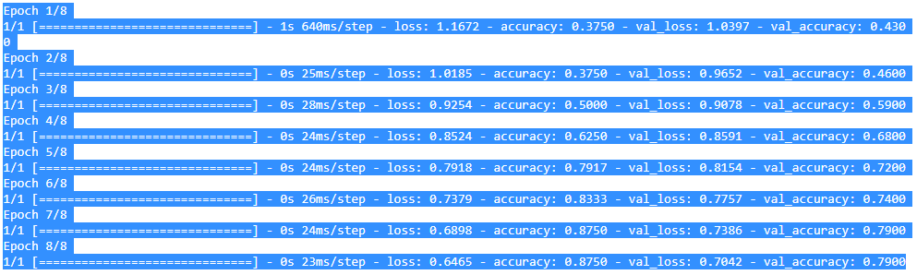
Deep Learning Training Model-1
Deep Learning Multiclass Classification performed on UC Irvine Wine Dataset.
Dataset Link: https://archive.ics.uci.edu/ml/datasets/wine
Model is trained using 64 components-1 Hidden layer, epochs=8,batch_size=100,optimizer="rmsprop"
Training accuracy is: 0.8750 and validation accuracy is: 0.7900

Slide 3
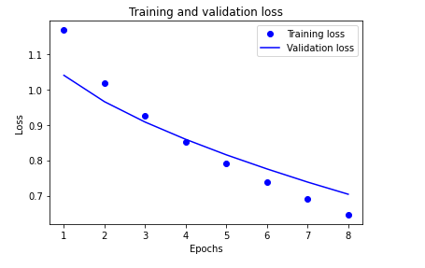
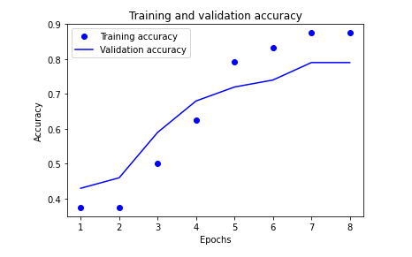
Deep Learning Training Model-1
Plotting the training and validation loss
Plotting the training and validation accuracy

Slide 4
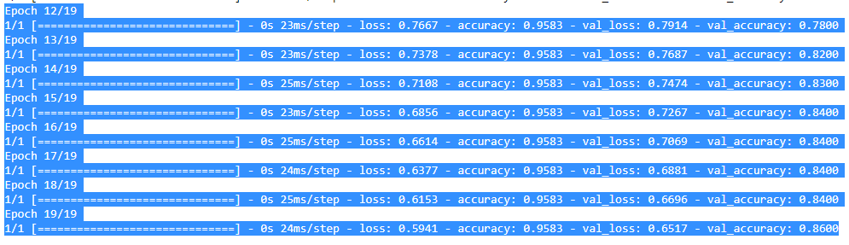
Deep Learning Training Model-2
Model is trained using 32 components-1 Hidden layer, epochs=19,batch_size=100,
optimizer="rmsprop"
Training accuracy is: 0.9583 and validation accuracy is: 0.8600.

Slide 5
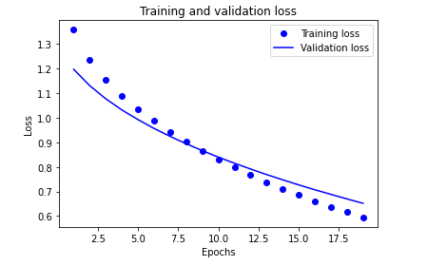
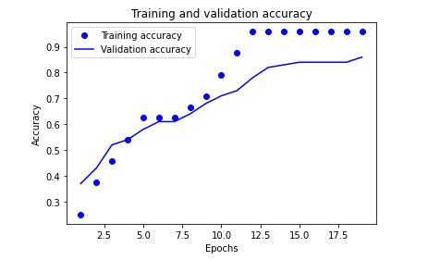
Deep Learning Training Model-2
Plotting the training and validation loss
Plotting the training and validation accuracy

Slide 6

Deep Learning Training Model-3
Model is trained using 24 components-3 Hidden layer, epochs=25,batch_size=100,optimizer="rmsprop“
Training accuracy is: 0.9583 and validation accuracy is: 0.9400.

Slide 7
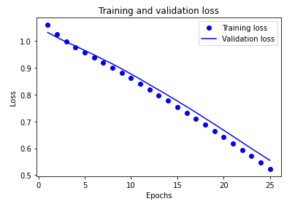
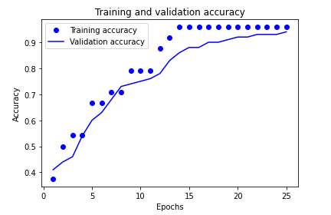
Deep Learning Training Model-3
Plotting the training and validation loss
Plotting the training and validation accuracy

Slide 8
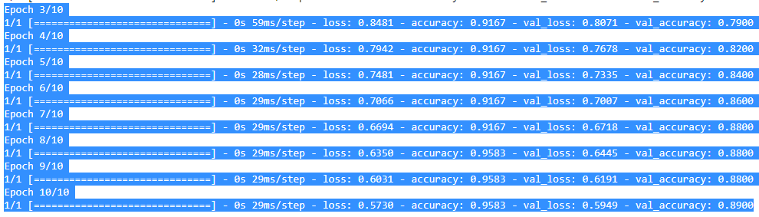
Deep Learning Training Model-4
Model is trained using 48 components-1 Hidden layer, epochs=10,batch_size=80,optimizer="rmsprop"
Training accuracy is: 0.9583 and validation accuracy is: 0.8900.

Slide 9
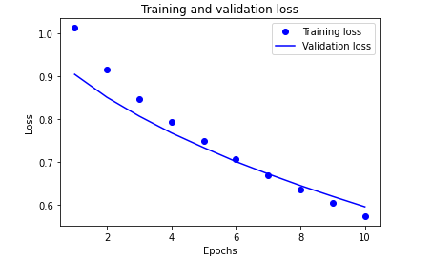
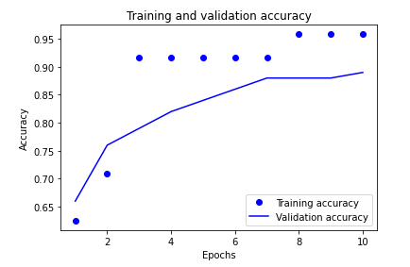
Deep Learning Training Model-4
Plotting the training and validation loss
Plotting the training and validation accuracy

Slide 10
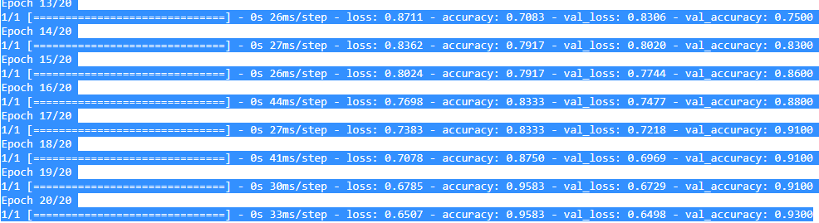
Deep Learning Training Model-5
0.9300
48 components-1 Hidden layer, epochs=20, batch_size=80,
optimizer="adam“
Training accuracy is: 0.9583 and validation accuracy is: 0.9300.

Slide 11
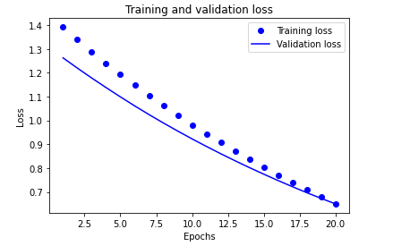
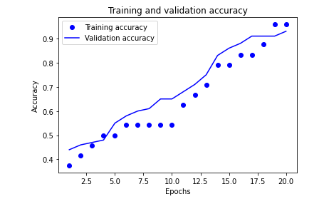
Deep Learning Training Model-5
Plotting the training and validation loss
Plotting the training and validation accuracy

Slide 12


